Slide 1
The Influence of International Crude Oil and Gas Prices on Kazakhstan's Exchange Rate
Mussa Aman
Yerassyl Otarov
Data Science

Slide 2
WHY THIS IS IMPORTANT
The prices of imported goods are affected by exchange rates.
The fluctuation of commodity prices affects people's lives all the time.
Food, clothing, housing, transportation and …
It changed from 140 to 476 / 02.01.2000-09.01.2022

Slide 3
Prediction
Precausion
Understand
Solution
WHY THIS IS IMPORTANT
It is important for investment.
It is critical for making financial decisions.
It is essential for us to know how Macroeconomic works.
Know how to deal with the rise and fall of the exchange rate

Slide 4
Research Hypothesis
Price Of Oil
Price Of Gas
01
02
Export & Import
Export & Import
When the price of Gas & Oil increases, the exchange rate of
USD-KZT
falls.

Slide 5
Price of Gas
Research Hypothesis
Price Of Gas
Kazakhstan's economic exports are dependent on crude petroleum and petroleum gas.
Once the price of crude and gas decreases, a trade deficit will occur.
Once the price of crude and gas decreases, a trade deficit will occur.
When the price of Gas & Oil decreases, the exchange rate of
USD-KZT
.

Slide 6
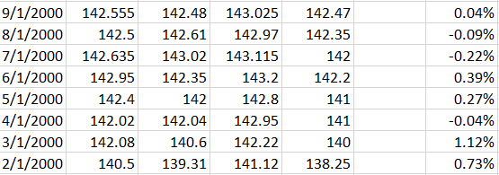
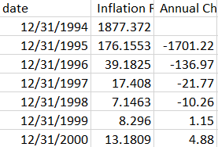
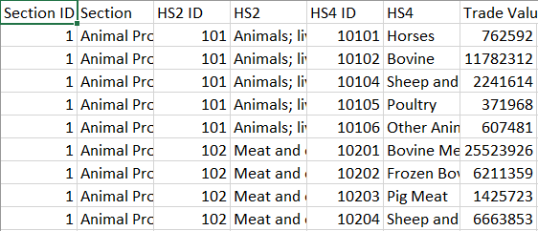
Datasets
Here, 3 datasets are collected:
The change of exchange rate USD – KZT monthly from 2000 to 2022 year.
The export & import from 2000 to 2022.
Inflation rate from 2000 to 2022

Slide 7
Thanks for Attention

